Slide 1
Introduction to IoT System – Educational Platforms: Arduino and Raspberry Pi
Vraj Suratwala
Department of ICT, VNSGU

Slide 2
Introduction & Arduino
IoT (Internet of Things) is a system in which physical devices are connected to a network to sense, collect, process and exchange data. IoT systems generally consist of sensors, processing units, communication technologies and actuators.
For learning and developing IoT applications, Arduino and Raspberry Pi are two widely used educational platforms.
Arduino
Arduino is a microcontroller-based development platform used to build electronic and IoT prototypes. It can receive input from sensors, process the input according to a program, and control output devices such as LEDs, motors and displays.

Slide 3
Arduino
Basic flow:
Sensor/Input → Arduino → Processing → Actuator/Output
Features of Arduino:
Microcontroller-based platform.
Simple programming and hardware interface.
Supports digital and analog input/output.
Can interface with various sensors and actuators.
Low cost and suitable for beginners.
Commonly used for embedded and IoT prototypes.
Applications:
Temperature and humidity monitoring
Smart lighting
Home automation
Robotics
Sensor-based systems

Slide 4
Raspberry Pi
Raspberry Pi is a small single-board computer that can run an operating system and execute programs. It provides GPIO pins for connecting sensors and electronic components and also supports communication through interfaces such as USB, Ethernet and wireless networking, depending on the model.
Basic flow:
Sensor/Input → Raspberry Pi → Program/Processing → Network/Actuator
Features of Raspberry Pi:
Small single-board computer.
Runs an operating system.
Provides GPIO interfaces.
Supports networking and Internet connectivity.
Can run programming languages such as Python.
Suitable for applications requiring more processing and networking capabilities.
Applications:
IoT gateways
Home automation
Monitoring systems
Robotics
Edge computing
Web-based IoT applications

Slide 5
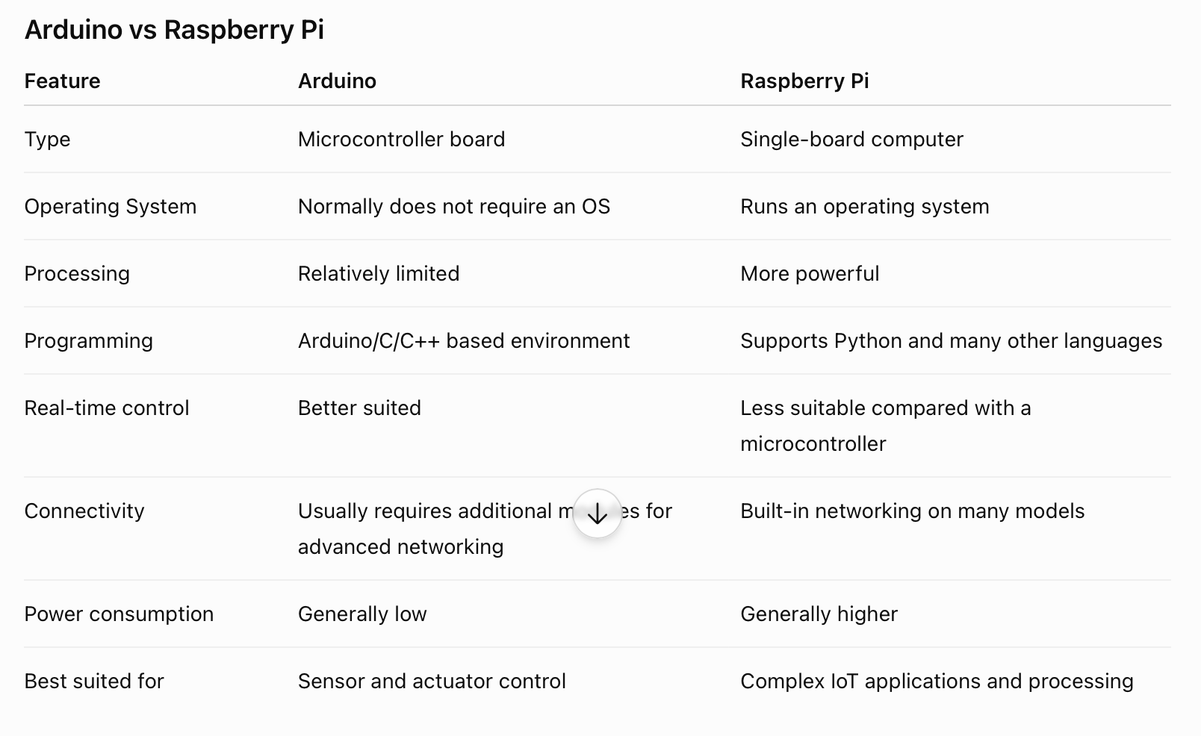

Slide 6
Introduction of Raspberry Pi – Hardware and Peripherals
Vraj Suratwala

Slide 7
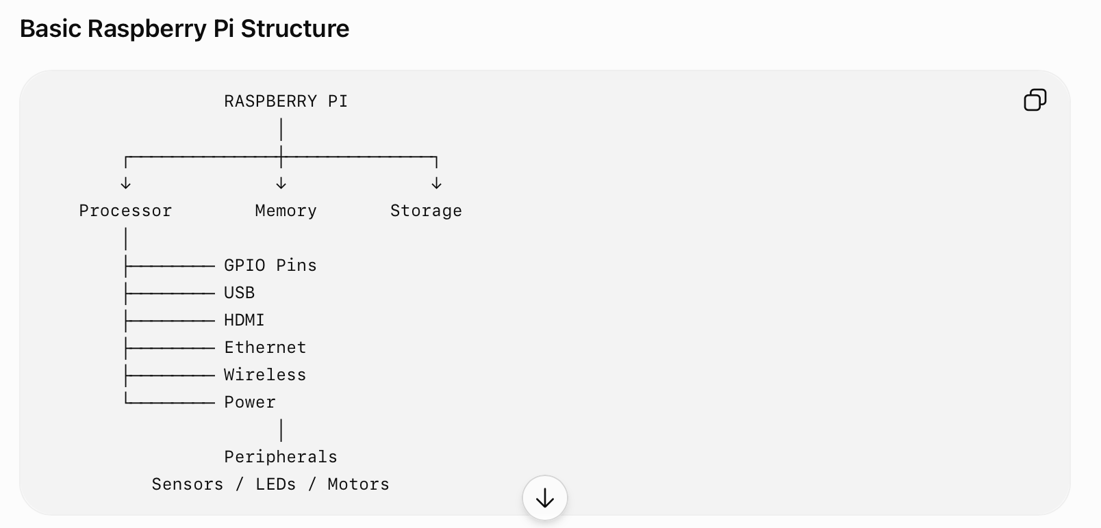
Introduction
Raspberry Pi is a compact single-board computer (SBC) designed for education, programming, electronics and embedded applications. Unlike a basic microcontroller board, Raspberry Pi can run an operating system and perform tasks similar to a small computer.

Slide 8
Major Hardware Components
1. Processor (CPU)
The processor performs calculations and executes instructions. Raspberry Pi models use ARM-based processors.
2. RAM
RAM temporarily stores programs and data that are currently being processed. The amount of RAM depends on the Raspberry Pi model.
3. Storage
Raspberry Pi commonly uses a microSD card for storing the operating system, programs and user data.

Slide 9
Major Hardware Components
4. GPIO Pins
GPIO stands for General Purpose Input/Output. These pins allow Raspberry Pi to communicate with external electronic components such as:
LEDs
Push buttons
Sensors
Relays
Displays
GPIO pins can be configured as inputs or outputs.

Slide 10
Major Hardware Components
5. USB Ports
USB ports allow connection of peripherals such as:
Keyboard
Mouse
USB storage
Cameras and other USB devices
6. HDMI
HDMI is used to connect Raspberry Pi to a monitor or display.
7. Ethernet
The Ethernet interface provides wired network connectivity on models that include it.

Slide 11
Major Hardware Components
8. Wireless Connectivity
Many Raspberry Pi models provide Wi-Fi and Bluetooth, allowing wireless communication with networks and devices.
9. Power Supply
Raspberry Pi requires an external power supply, typically connected through its designated power connector.

Slide 12
Raspberry Pi Peripherals
A peripheral is an external or supporting device that communicates with the Raspberry Pi.
Common peripherals include:
Peripheral Purpose
LED Visual output
Push Button User input
Temperature Sensor Temperature measurement
Ultrasonic Sensor Distance measurement
Camera Image/video capture
LCD/Display Display information
Motor Mechanical movement
Relay Control electrical devices
Keyboard & Mouse User interactio

Slide 13
Thank You
Vraj Suratwala
Department of ICT, VNSGU

